Slide 1
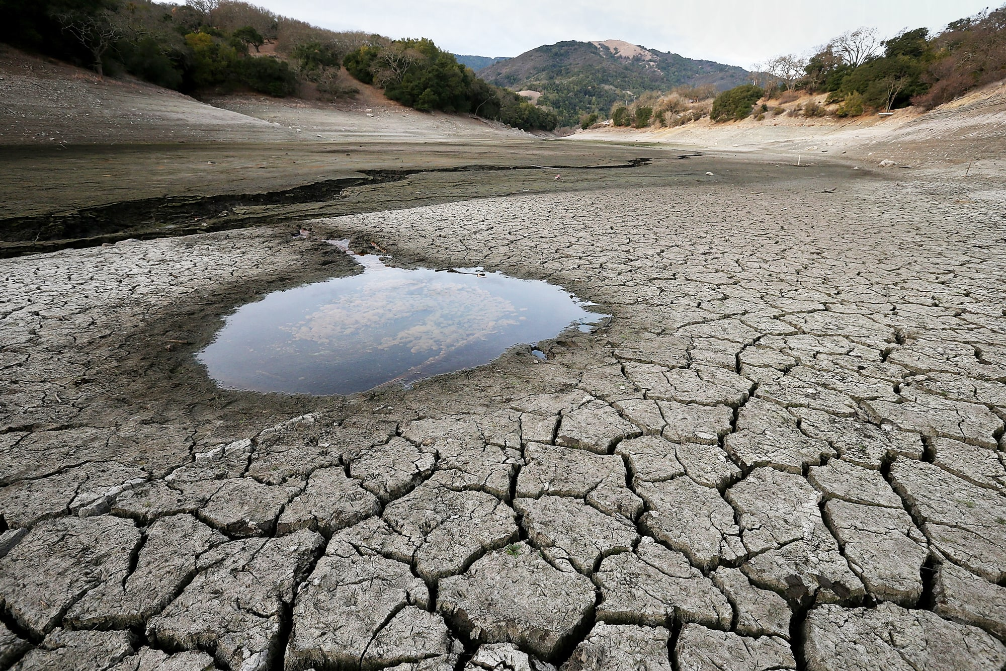
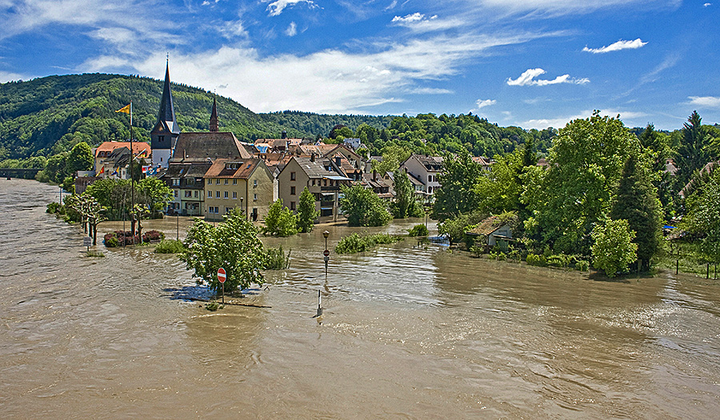
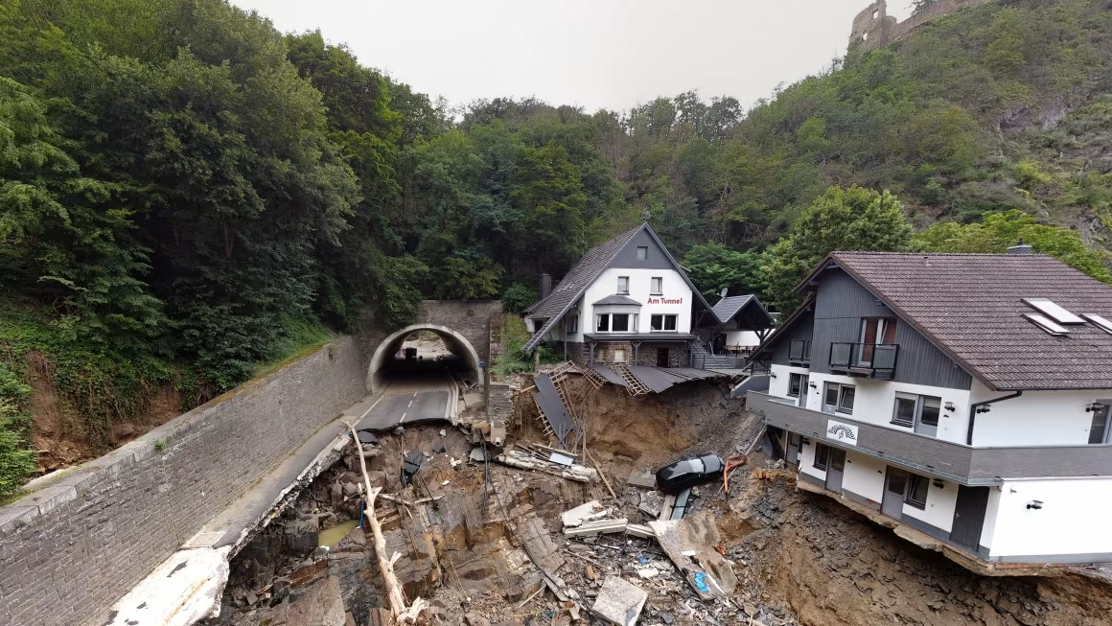
Rainfall Analysis & Drought Assessment for the main cities in Germany
Nekky Tang Wai Lung

Slide 2
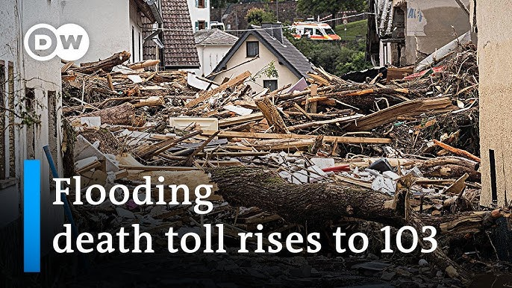
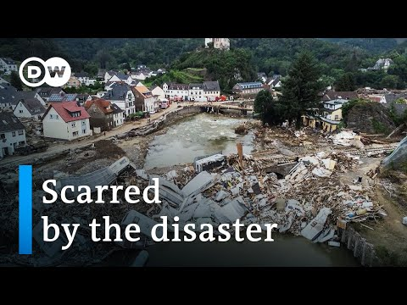
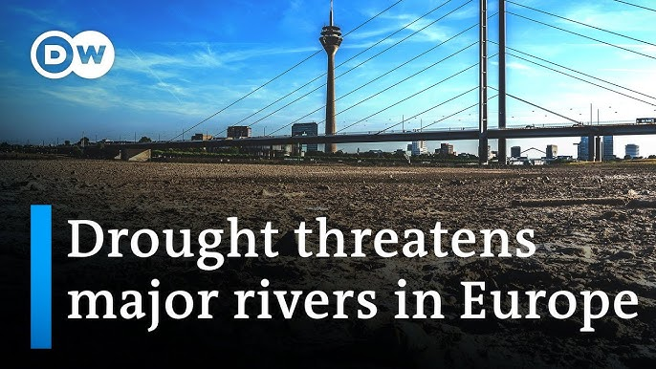
Germany news 2015-2023
Multi-year drought (2018-2023):
Germany faced a prolonged period of drought, with 2018-2023 being particularly dry and hot.
July 2021 floods:
A particularly devastating flood event occurred in July 2021, primarily affecting North Rhine-Westphalia and Rhineland-Palatinate.
Impact on Agriculture:
In July 2022, a temperature of over 40 degrees was measured for the first time north of 53 degrees latitude in Hamburg.
Flooding in Dec 2023/Jan 2024 in southern Germany:
Heavy rainfall and snowmelt also led to flooding in late 2023 and early 2024, though the intensity of precipitation was lower than in July 2021, resulting in less severe damage

Slide 3

Presentation Agenda
1. Project Overview - Dataset and objectives
2. Rainfall Pattern Analysis - Climate type comparisons
3. Seasonal Variations - Temporal patterns across regions
4. Drought Assessment Methodology - SPI calculation framework
5. Key Findings - Multi-scale drought indicators
6. Practical Applications - Decision support tools
7. Recommendations - Next steps and implementation

Slide 4
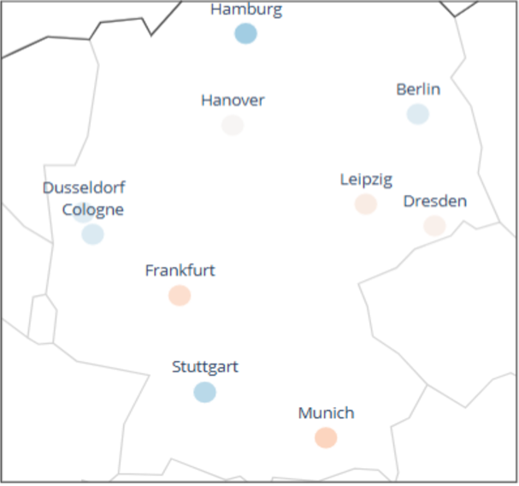
Dataset Overview
Total Records: 1,080
Time Period: 2015 - 2023 (9 years)
Temporal Granularity: Monthly data
Geographic Coverage: Oceanic and Continental climate zones
Cities Covered: 10 major German cities 'Berlin' 'Hamburg’ 'Cologne’ 'Frankfurt' 'Dusseldorf' 'Hanover' 'Stuttgart’ 'Munich''Leipzig’ 'Dresden’

Slide 5
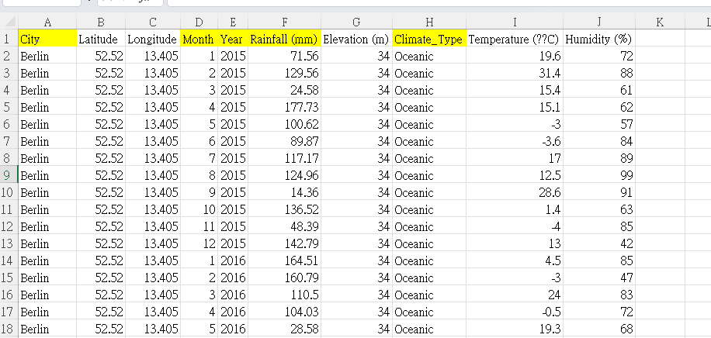
Dataset Overview
Variable | Type
Rainfall (mm) | Continuous
Temperature (°C) | Continuous
Humidity (%) | Integer
Elevation (m) | Integer
Climate Type | Categorical

Slide 6
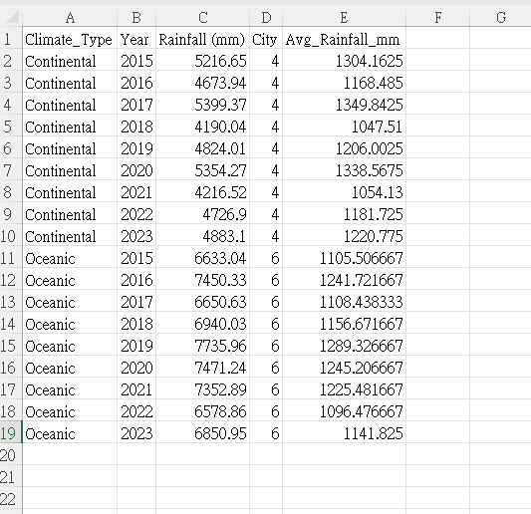
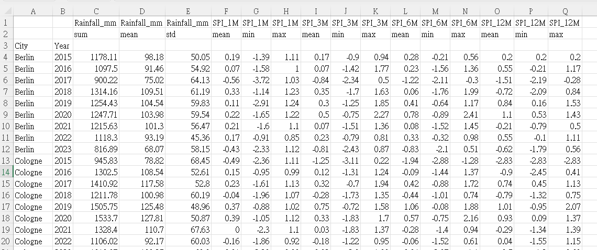
Dataset Overview
rainfall_by_climate_type
spi_annual_summary

Slide 7
Dual Analysis Approach
1. Exploratory Data Analysis
Objective:
Understand rainfall patterns and seasonal variations across climate types
Annual rainfall aggregation
Climate type comparisons
Seasonal pattern identification
2. Drought Index Calculation
Objective:
Quantify drought severity using standardized precipitation
Multi-scale SPI computation
Statistical distribution fitting
Drought classification system

Slide 8

Annual Rainfall Patterns by Climate Type
Germany does not have a distinct wet and dry season.
Aggregated monthly rainfall data to calculate annual totals for each city
Computed average annual rainfall for each climate type by dividing total rainfall by the number of cities in that climate zone
Generated time series visualization showing annual rainfall trends

Slide 9
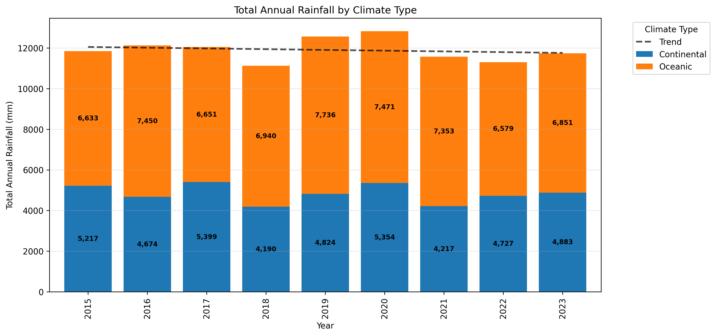
Annual Rainfall Patterns by Climate Type
Key Insights
Distinct rainfall patterns observed across different climate zones
Year-over-year variations indicate climate volatility
Some climate types show increasing/decreasing trends

Slide 10

Seasonal Rainfall Variations
Methodology:
Mapped monthly data to seasons
Calculated seasonal rainfall averages for each climate type
visualizations for the two climate types showing year-over-year seasonal variations
Winter: Dec-Feb | Summer: Jun-Aug
Spring: Mar-May | Autumn: Sep-Nov

Slide 11
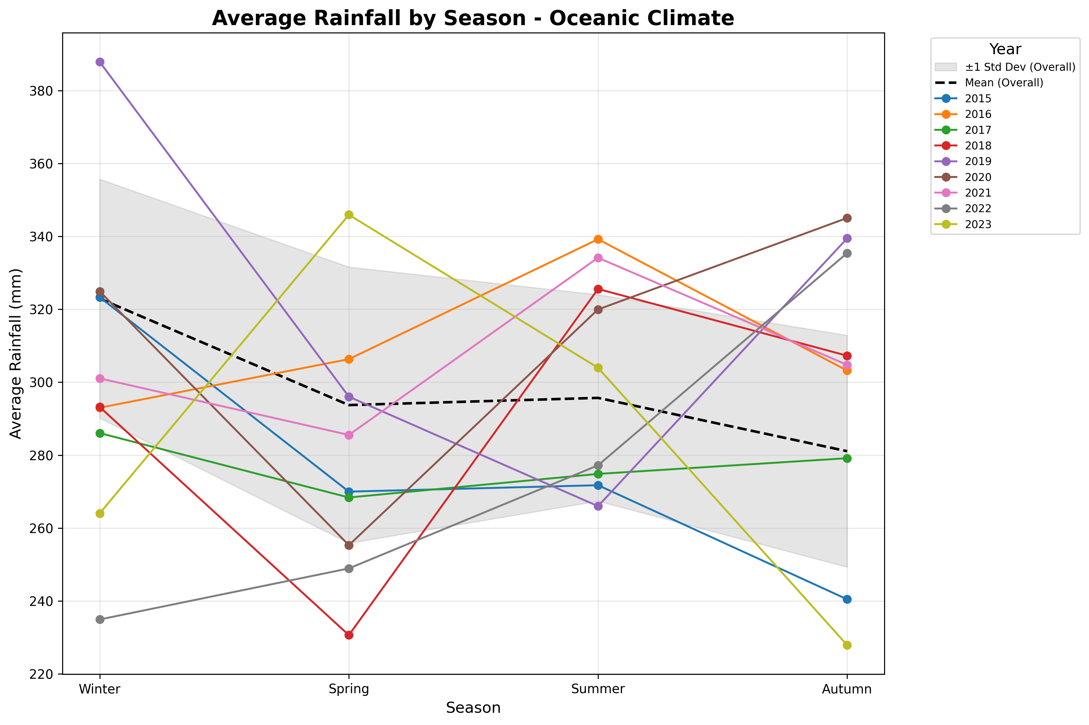

Slide 12
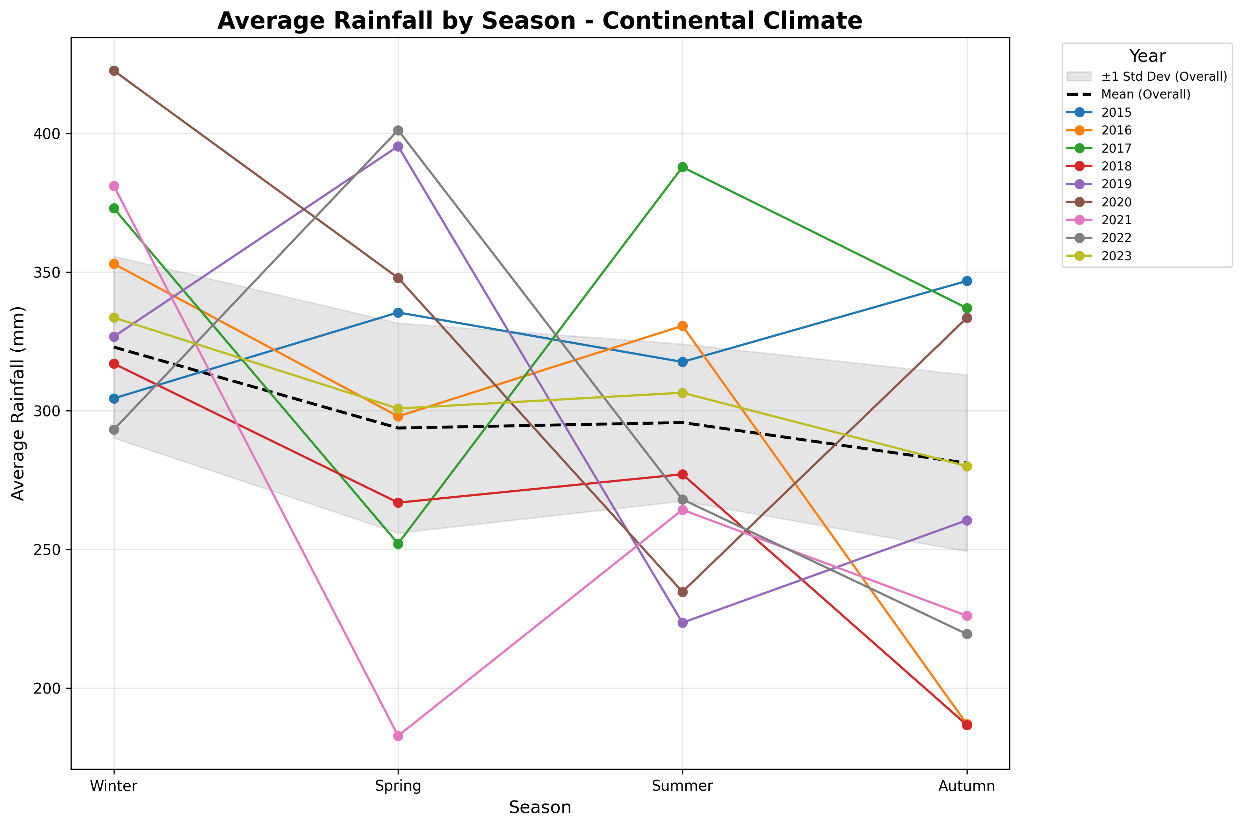

Slide 13
Drought Index Calculation: Standardized Precipitation Index (SPI) helped with claude
Statistical Approach: distribution fitting to model precipitation patterns for each city
Time Scales: Calculates SPI values for 1, 3, 6, and 12-month periods to capture short-term to long-term drought conditions
SPI Value | Classification | Probability (%) | Typical Impacts
≥ 2.0 | Extremely Wet | 2.3 | Flooding risk, infrastructure stress
1.5 to 2.0 | Very Wet | 4.4 | Above normal runoff, full reservoirs
-0.5 to 0.5 | Near Normal | 38.3 | Typical conditions
-1.0 to -0.5 | Slightly Dry | 9.2 | Some concern for rain-fed agriculture
-1.5 to -1.0 | Moderately Dry | 4.4 | Crop yield reduction, water restrictions
≤ -2.0 | Extremely Dry | 2.3 | Severe impacts, emergency measures
Key Features- Multi-Scale Drought Assessment:
SPI-1: Monthly conditions
(agricultural drought, immediate impacts)
SPI-3: Seasonal conditions
(soil moisture, crop yields)
SPI-6: Medium-term trends
(reservoir levels, streamflow)
SPI-12: Annual patterns
(groundwater, long-term water resources)

Slide 14
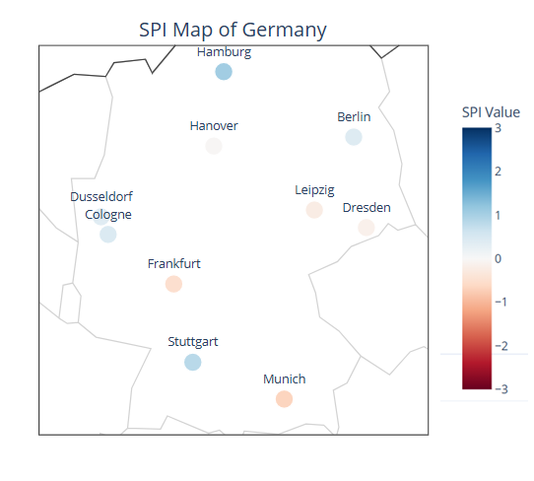

Key Findings
Do you wanna see 👆🏻click me =]
How all Germany cities’ SPI look like?
Germany 2023 – SPI6

Slide 15
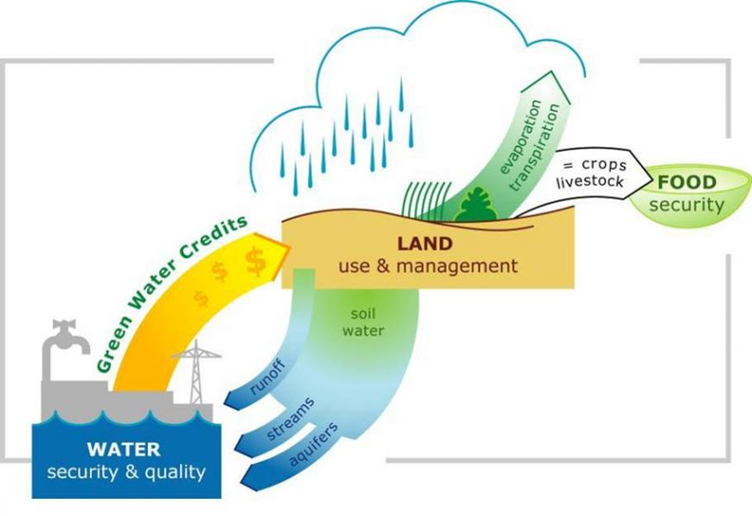
Practical Applications
Water Resource Management
Reservoir operation optimization
Irrigation scheduling
Supply allocation decisions
Emergency Planning
Drought declaration triggers
Resource mobilization
Public communication
Policy Development
Water use restrictions
Agricultural support programs
Infrastructure investment
Risk Assessment
Insurance pricing
Crop selection guidance
Economic impact modeling

Slide 16
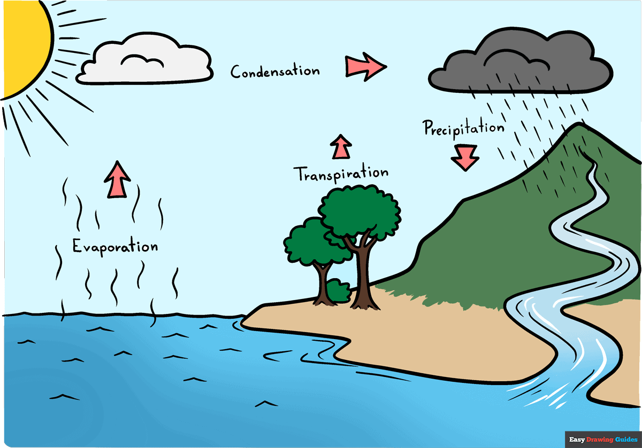
Thank you

